Slide 1
Monday, January 23, 2017
Write In Your Agenda:
Write In Your Monitoring Log:
CW:
Finish Food Chains and Food Webs Power Point and Note sheet.
“What’s Eating You?” worksheet.
HW:
Finish classwork.
Response to Warm-Up:
Describe the difference between predator and prey.
You will need:
Pencil
New Monitoring Log
Food Chains and Food Webs note sheet

Slide 2
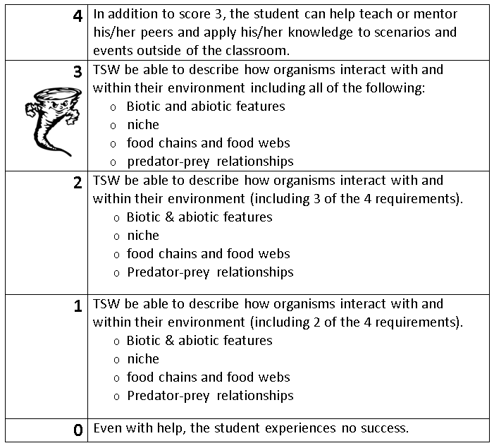
Learning Goal and Scale
TSW be able to describe how organisms interact with and within their environment (including biotic and abiotic features, niche, food chains & webs, and predator-prey relationships).

